Slide 1
RFM Customer Retention Strategy
Keerti Gurung
keerti.gurung.data@gmail.com
2026-09-14

Slide 2
Business Questions
This project answers two questions:
Which customer segments drive the most revenue?
Which segments carry the highest churn risk (90+ days without a purchase)?

Slide 3
Data & Methodology
Dataset:
UK Online Retail (UCI Repository)
541,909 transactions → 4,338 customers after cleaning
Period: Dec 2010 – Dec 2011
Tools Used: SQL | Python (Pandas, Matplotlib) | Power BI
Method:
RFM quintile scoring (1-5) on Recency, Frequency, Monetary
7 segments via priority-ordered decision tree
Churn threshold: 90+ days without a purchase

Slide 4
Segmentation
Hierarchy: Recency → Frequency → Monetary
First match wins. Default = Low Priority
Segment | Customers | Criteria
Champions | 947 | R≥4, F≥4, M≥4
Loyal Customers | 454 | R≥3, F≥4, M≥3
Potential Loyalists | 190 | R≥4, F=3, M≥3
Can't Lose Them | 173 | R≤2, F≥4, M≥4
At Risk | 207 | R=2, F≥3, M≥3
Hibernating | 106 | R≤2, M≥4
Low Priority | 2,261 | All remaining

Slide 5
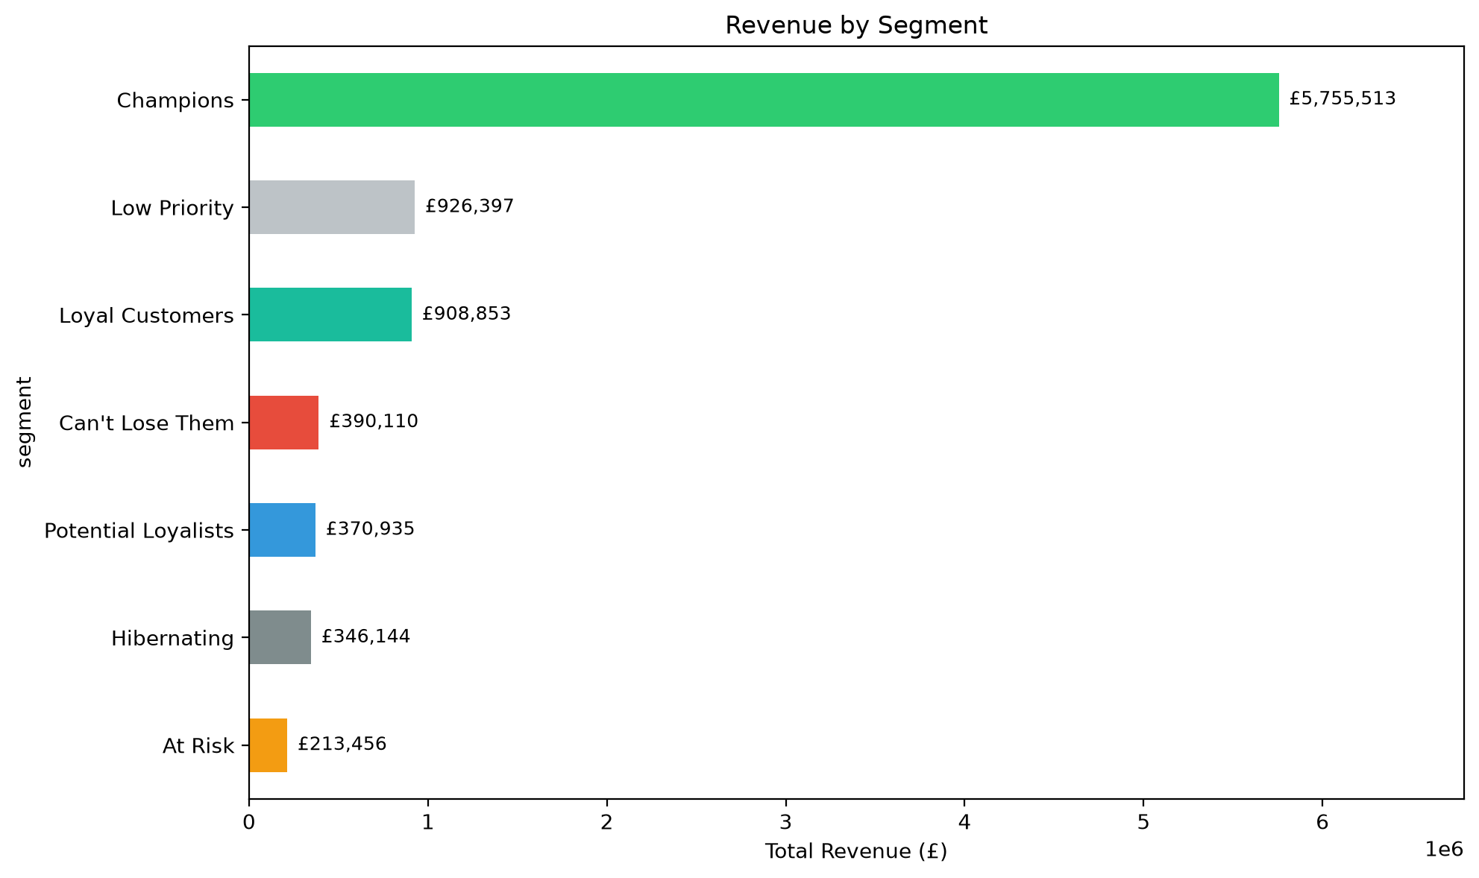
Revenue by Segment
Champions + Loyal Customers = 74.9% of revenue from 32.3% of customers
Low Priority = 52.1% of customers, only 10.4% of revenue

Slide 6
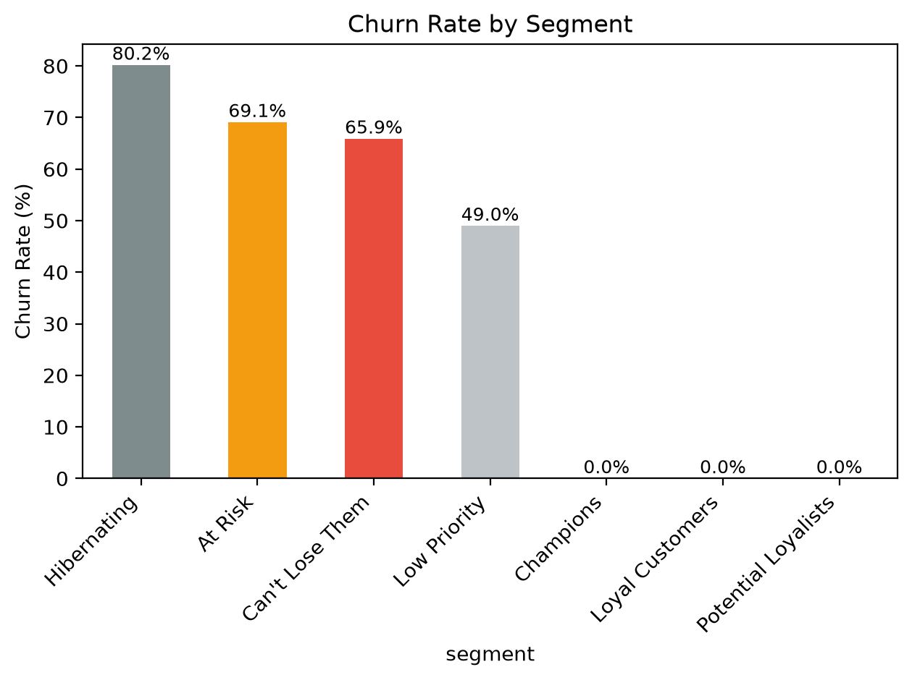
Churn rate by Segment
£1,035,269 total revenue at risk
Can't Lose Them: 93% churn, £398K lost
At Risk: 68% churn, £241K at risk
Hibernating: 100% churn, £129K lost

Slide 7
Key Findings
32.3% of customers drive 74.9% of revenue
£1.04M in revenue at risk across all segments
Can't Lose Them = highest urgency (173 customers, £398K)
At Risk = most recoverable (207 customers, £241K)
52.1% of base is Low Priority → focus spend on top 48%
Oct–Nov seasonal spike inflates churn counts

Slide 8
Recommendations
Champions - Loyalty tier / early access
Loyal Customers - Cross-sell complementary categories
Potential Loyalists - Bundle offer to increase purchase frequency
Can't Lose Them - Personalised win-back with exclusive time-limited offer
At Risk - Automated day-60 "we miss you" nudge
Hibernating - Low-cost email with high-value product recommendation
Low Priority - Suppress from campaigns

Slide 9
Limitations
90-day threshold is a business assumption, not data-driven
No external factors (marketing spend, economic conditions) considered
Segment boundaries are rule-based; adjacent quintiles may produce similar profiles
Data only covers 12-month period; Oct–Nov spike may misclassify seasonal buyers as churned.

Slide 10
Thank You
Keerti Gurung
keerti.gurung.data@gmail.com
github.com/keertigurung/rfm-customer-retention-strategy

